Slide 1

ERGONOMIC AI
CHAIR
DDQN TEAMS
Team members:
Pham Vo Dong – s3891968
Bui Quang Thanh Dat – s3927551
Mai Chi Nghi – s3864219
Le Anh Quan – s3877457

Slide 2


Identification
Description
The first wealth is health

Slide 3

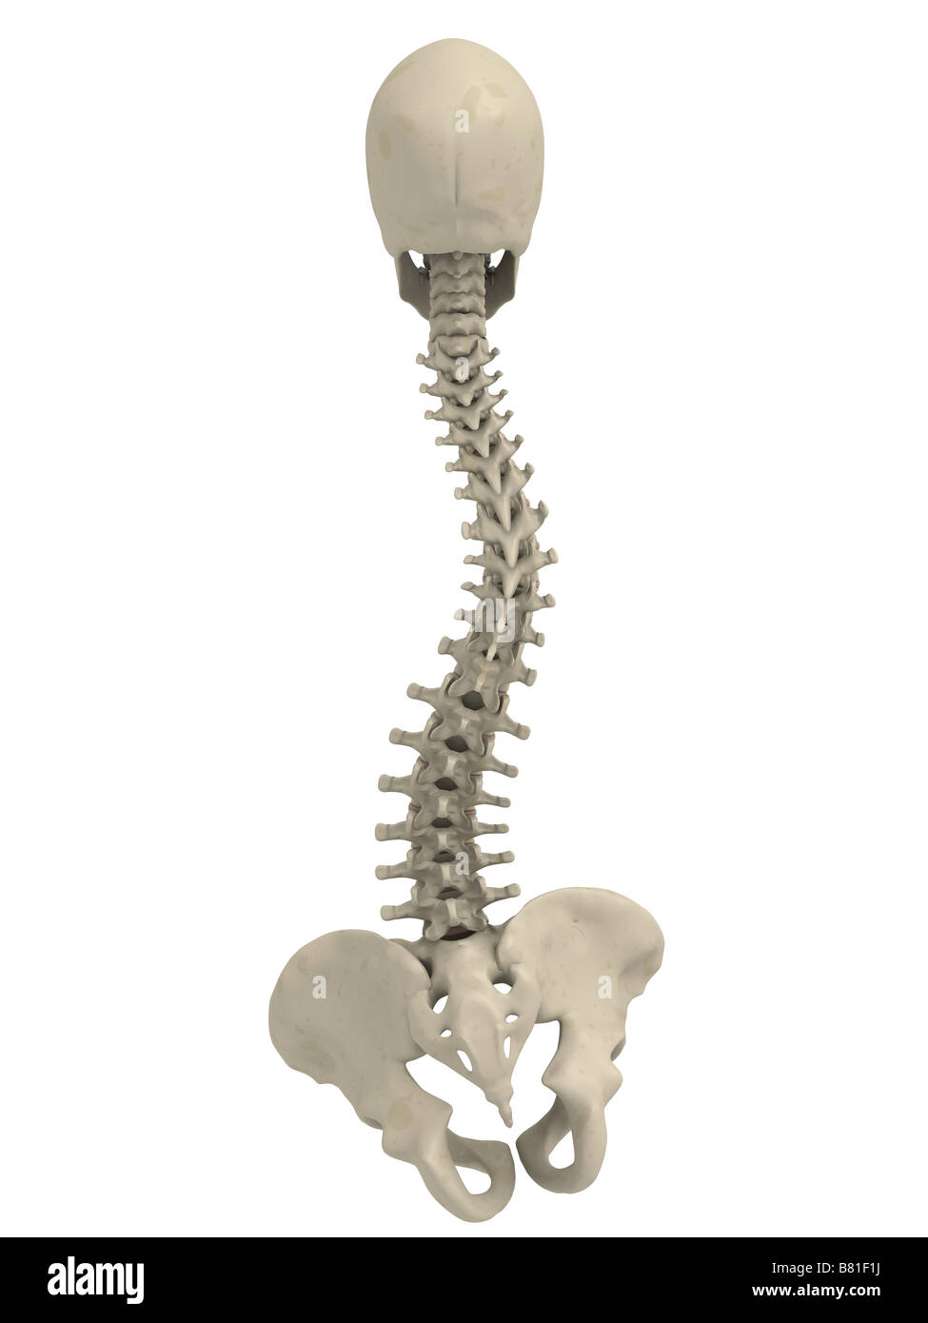


Problem 1: Scoliosis
According to the American Academy of Neurological Surgeons, scoliosis affects approximately six to nine million people in the United States, accounting for about 2-3 percent of the population (AANS).
Furthermore, the primary age of onset for scoliosis, according to the same source, is 10-15 years old, and it affects both genders equally.
=> Solution: use ergonomic chairs to fix user’s posture

Slide 4
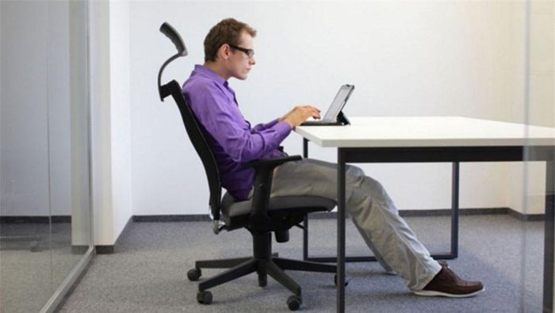

Problem 2: Current ergonomic chairs are lacking
Since users are not fully aware of the different features and adjustments, they do not use the chair in an optimal ergonomic way. => Too user-dependent
Meantime, users have no clue about the postures that he or she adopted without being given explicit feedback and instruction.
=>Users go back to wrong sitting posture on different chair.

Slide 5

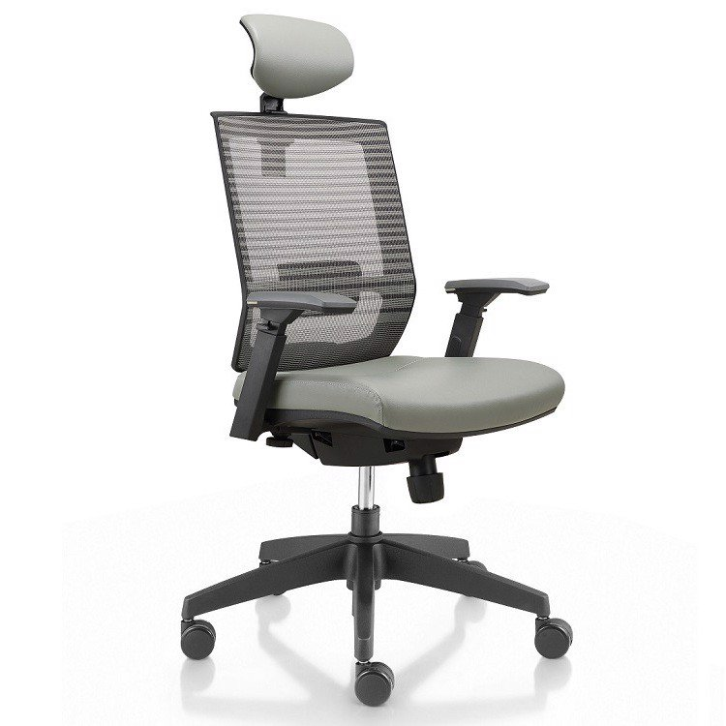


Solution
Combine the pre-existing ergonomic chair design with all its features for correcting posture
with the analytic power of Artificial Intelligent to automatically adjust the chair base on information recorded when the user sit to give the user a comfortable and healthy experience while giving feedback and advice to user to improve their sitting posture in the future.
+ =

Slide 6
Need / Want
Users / Market

Slide 7

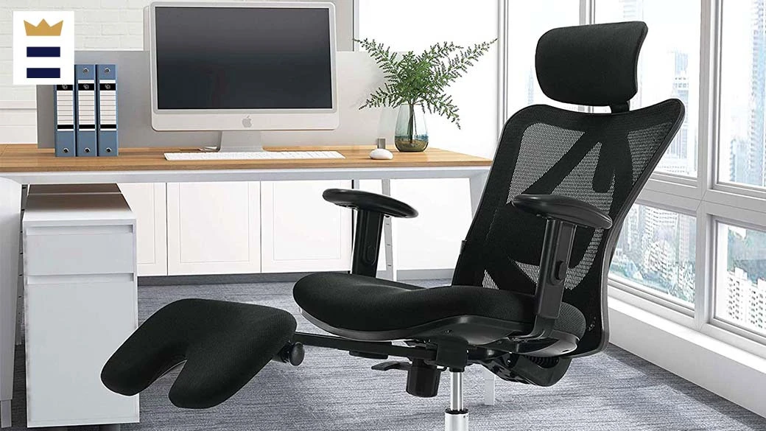
What is product need?
The bending design of the chair provides complete back support.
Adjusted to maintain a small backward tilt.
By adding or removing additional elements, they may customize their chairs to suit each individual and body form.
The chair is made of net, which absorbs sweat better than canvas, which is commonly used in chairs.

Slide 8
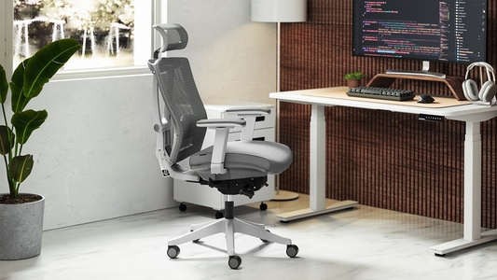
What is product want to?
Helping people feel more comfortable and reduce likelihood of getting from the spine or skin.
Increasing productivity.

Slide 9



What is types of users?
Office workers
People who have a computer setup

Slide 10

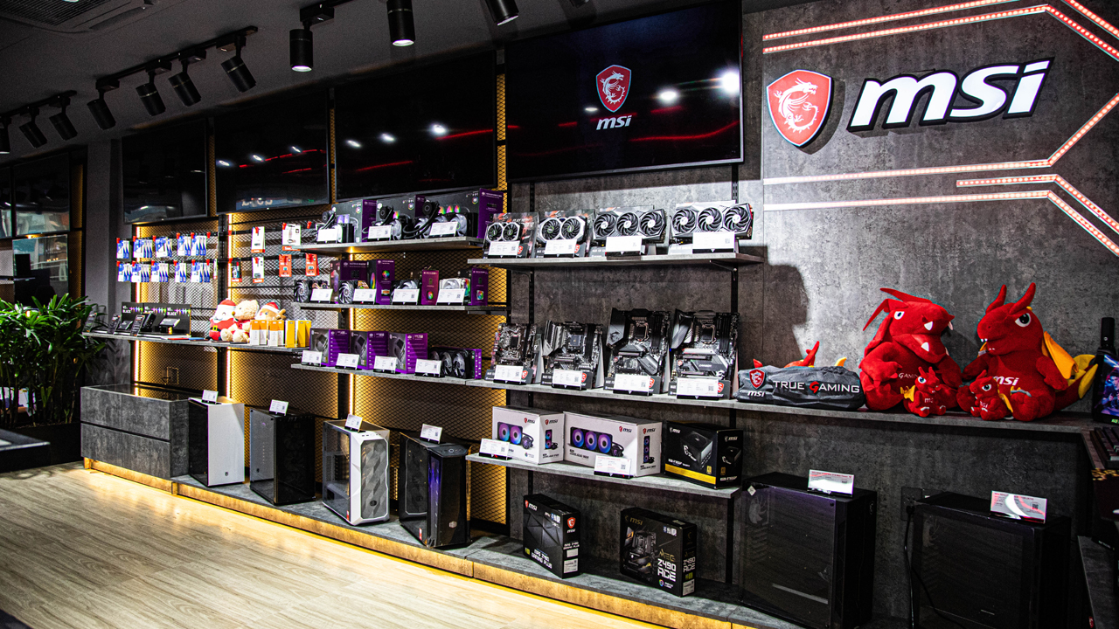
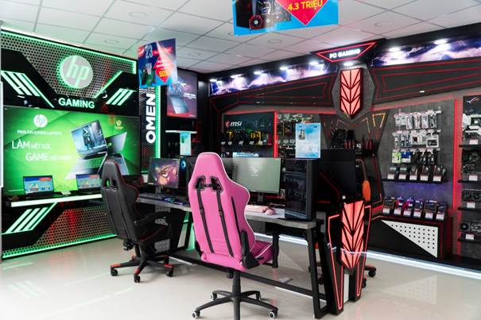
Where does us choose for market?
Stores have online and face-to-face shopping.

Slide 11

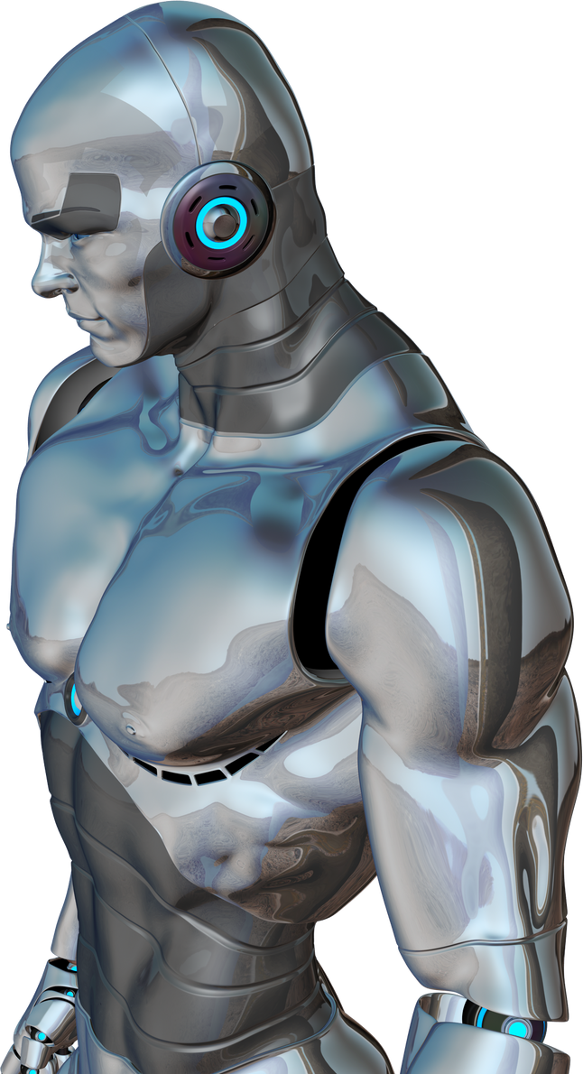
INOVATION

Slide 12

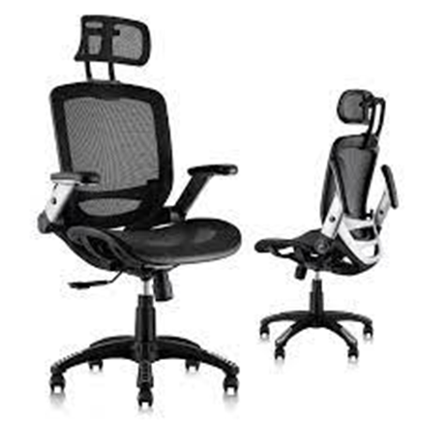
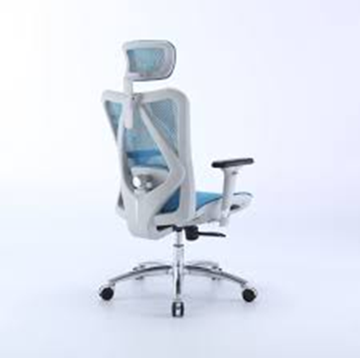
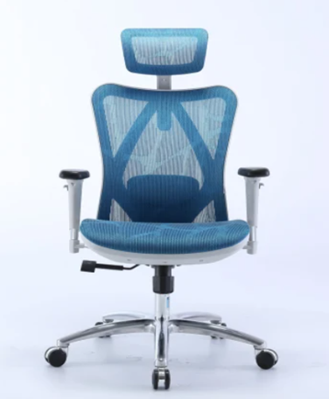
AI integrated specification
Scan the back of consumer’s body
Automatically adjust to fix correct position
Make adjustments as body movements

Slide 13

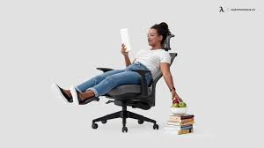
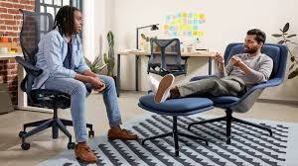
Improvement
Adding a wide range of adjustability
AI integration
Headrest & tilt comfortably

Slide 14
Mechanics
Design
Smart - Convenience - Comfortable

Slide 15
SCAN BODY

Slide 16
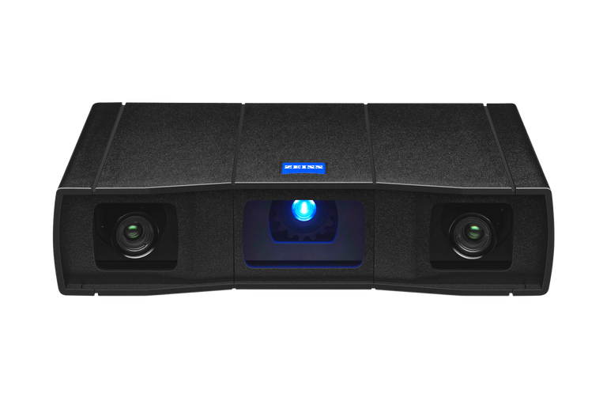
GOM SCAN 1

Slide 17
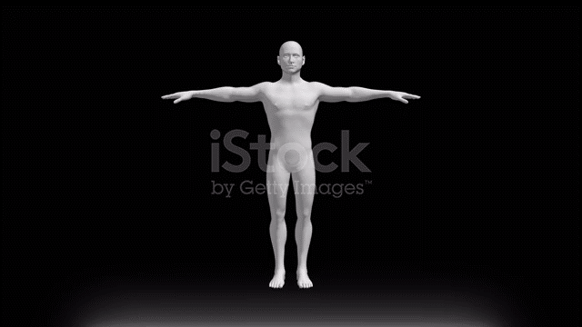

Slide 18
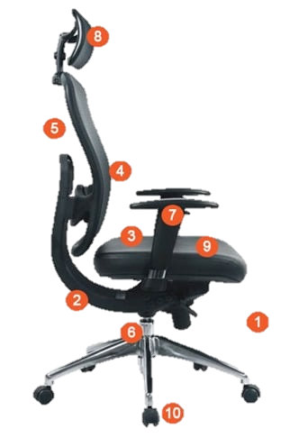
Headrest
Backrest recline
Backrest Lumbar support
Armrests
Seat tilt
Materials
Seat width and depth
Seat height
Swivel
Wheels

Slide 19

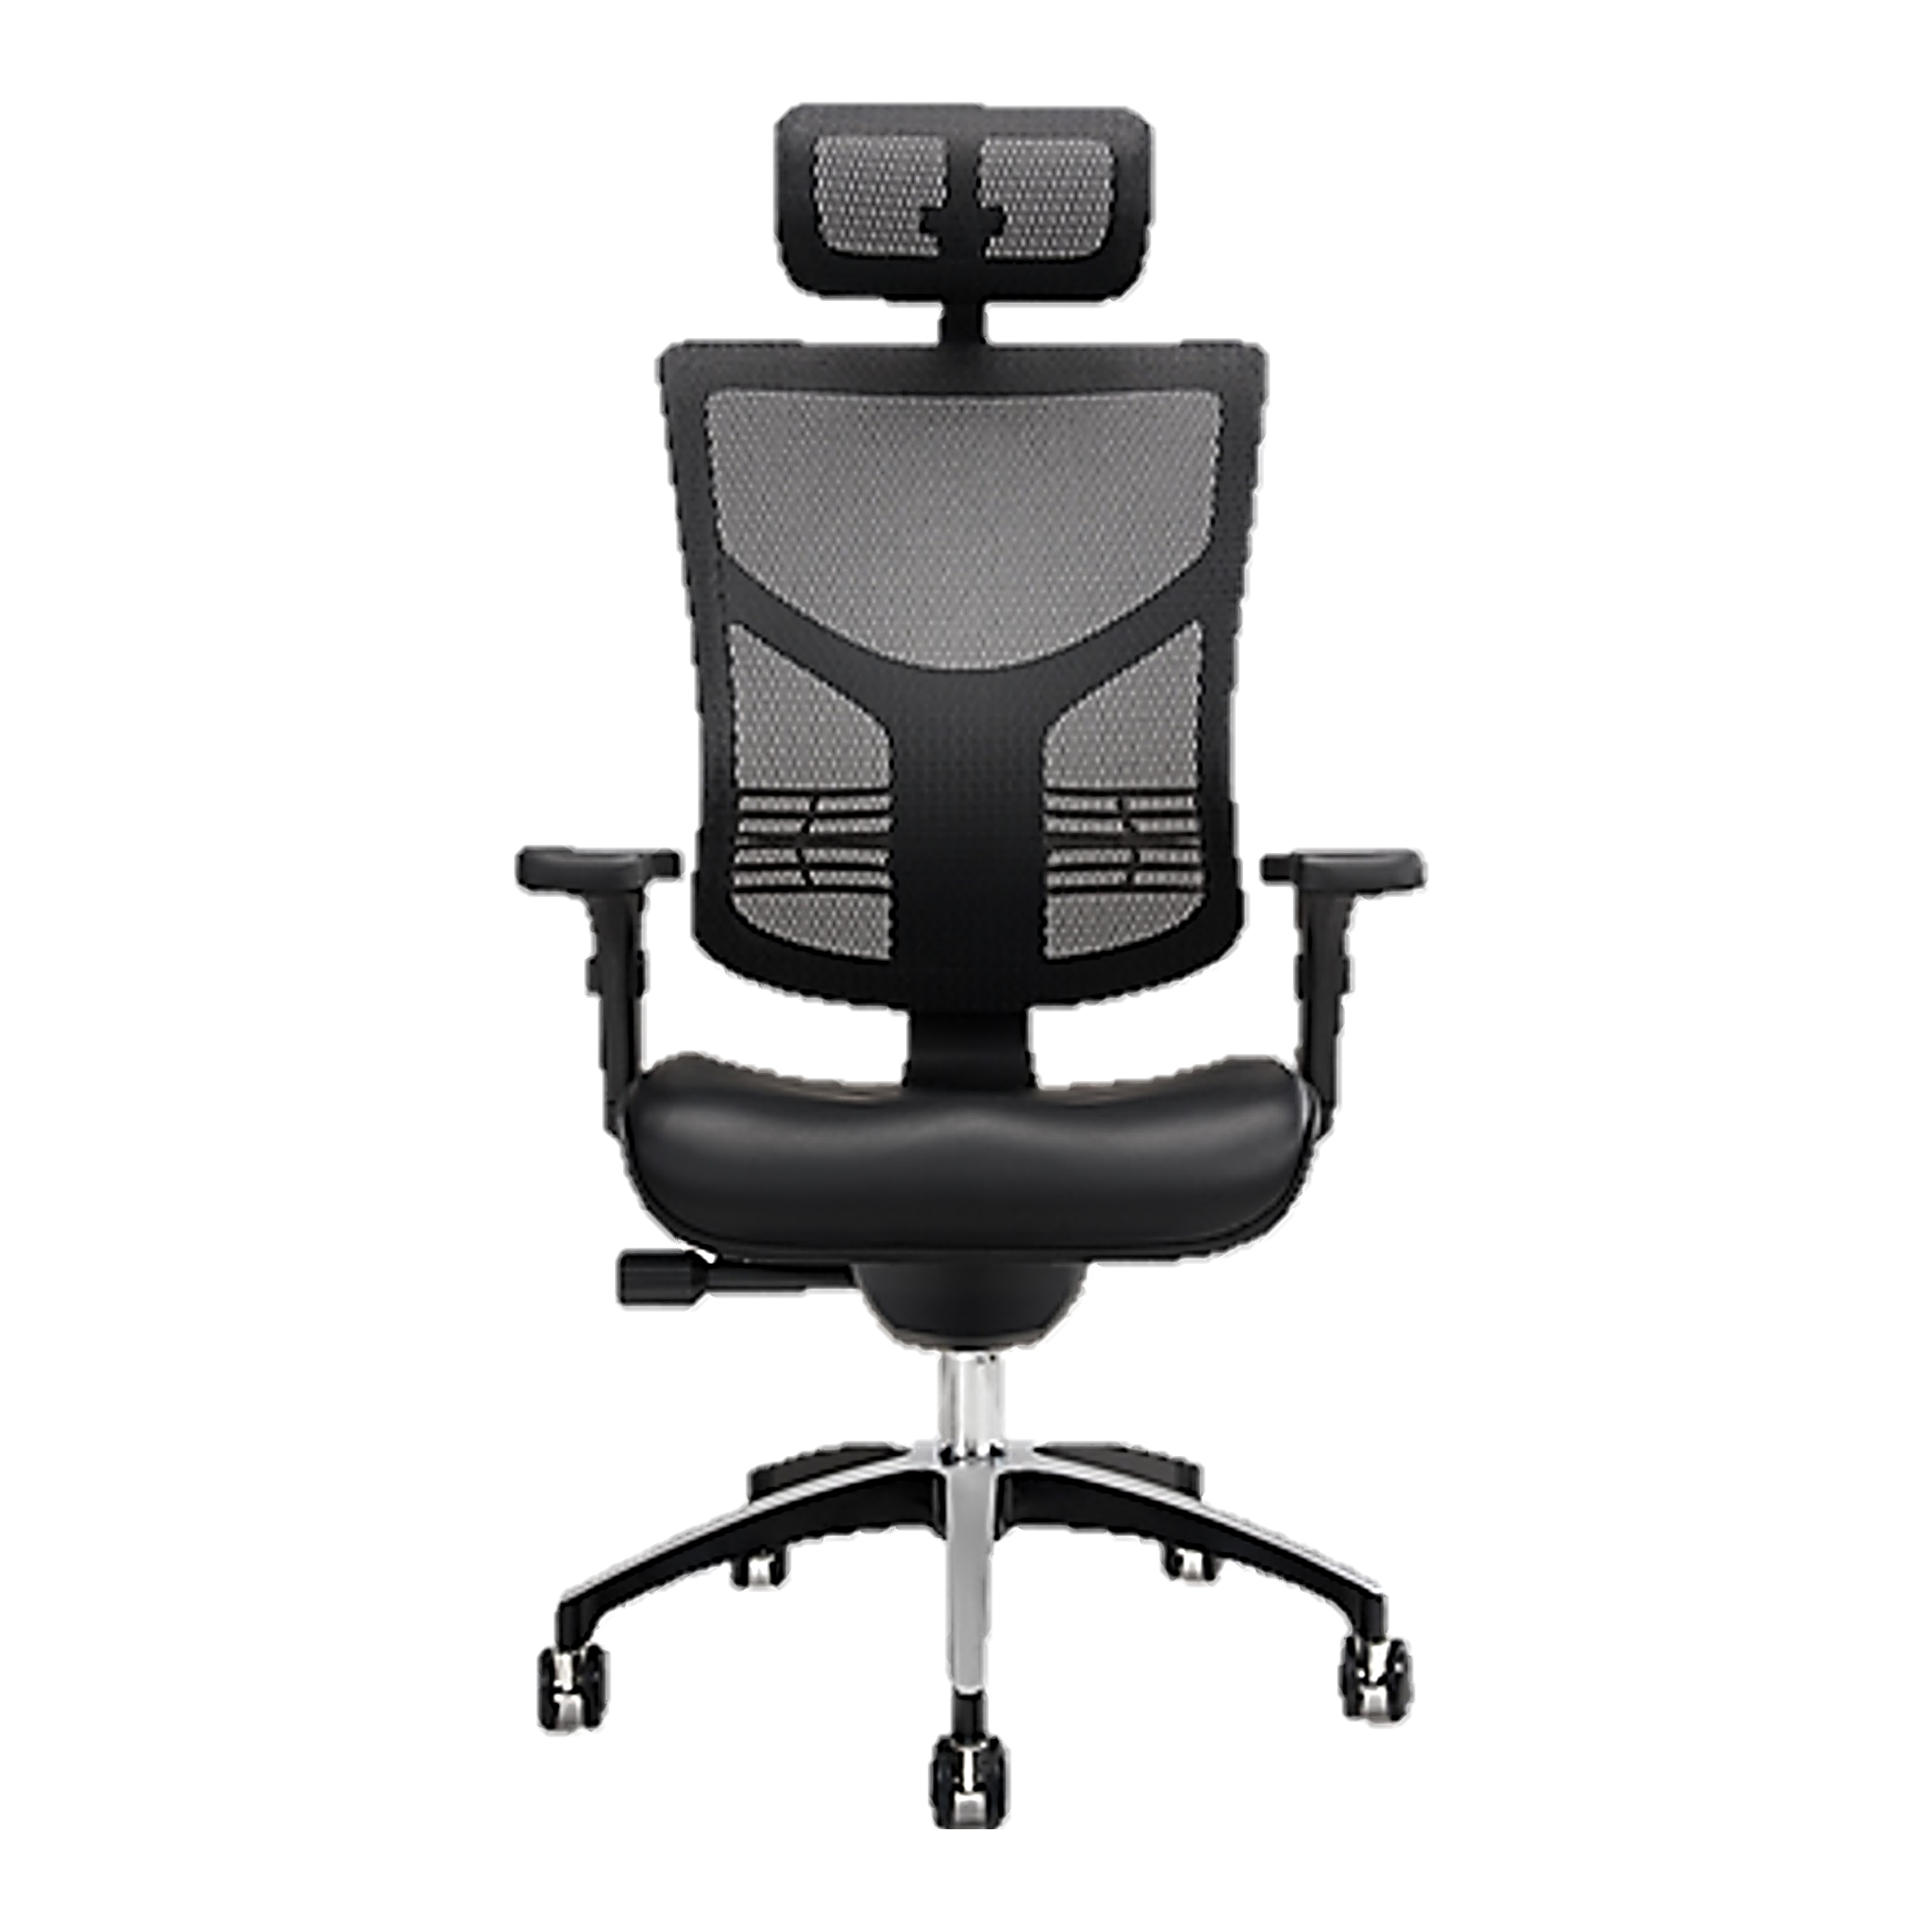

Slide 20

DDQN TEAMS
Thanks For Watching

